Slide 1

DT180 - Explore Solutions That Enable an Agile Transition to SAP S/4HANA Reiner Markheiser, Joerg Marenk, SAP

Slide 2

Questions?
If you have questions during the session, please use the Chat of the Broadcasting platform.
We have our colleagues Evan Stoddard, Frank Kuehn and John Krakowski in the background for answering your questions.

Slide 3
Exercise Information and System Access
Important Information to our session
Link to GitHub:
DT180 – Explore Solutions That Enable an Agile Transition to SAP S/4HANA

Slide 4
Agenda
SAP’s ALM Offerings
SAP Solution Manager with Focused Build
Architecture
Reporting Capabilities
Demos and Exercise
SAP Cloud ALM for Implementation
Details
Where to find more Information

Slide 5

SAP’s ALM Offerings

Slide 6

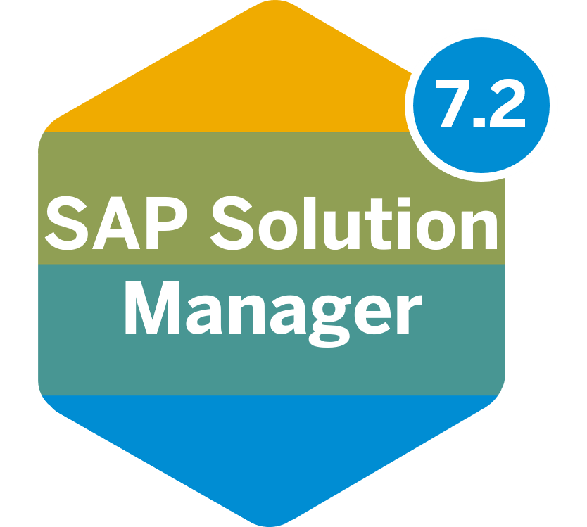


SAP’s ALM Offerings
SAP Solution Manager for hybrid solutions
SAP Cloud ALM available for multi cloud solutions
+
The entire process from requirement to build, test, deploy, go-live, and run in an integrated methodology and tool set.
Implement cloud-centric solutions with a pre-configured, content-driven guided workspace based on SAP Activate methodology and Best Practices.

Slide 7
When to choose which ALM Solution?
Case 1: Customer has an on-premise-centric solution and plans to keep it.
Case 2: Customer has a cloud-centric solution or is cloud only.
Case 3: Customer has a small, standard on-premise solution.
Case 4: Customer moves to cloud or standardized ALM.
or

Slide 8
SAP ALM Platforms – Planned Product Availability Strategy
SAP Solution Manager follows the maintenance strategy of the SAP Business Suite
Extended maintenance for process management, test suite, change & release management and ITSM in SAP Solution Manager 7.2 is automatically included in the optional extended maintenance for the SAP Business Suite 7.
SAP Solution Manager 7.2 is supported beyond 2030 – in customer specific maintenance*
There are no plans for further releases after SAP Solution Manager 7.2
SAP Cloud ALM and SAP Focused Run are not dependent on the SAP Business Suite, allowing mainstream maintenance beyond 2030. SAP plans no new on premise products in the ALM portfolio.
SAP Solution Manager, SAP Focused Run in mainstream maintenance
End of mainstream maintenance for SAP Solution Manager
End of extended maintenance for SAP Solution Manager
Now
End of 2027
End of 2030
SAP Solution Manager 7.2 - Operations
Customer specific maintenance
SAP Solution Manager 7.2 – Implementation & ITSM
Extended maintenance
Customer specific maintenance
SAP Focused Run
SAP Cloud ALM
*) See restrictions in SAP Note 52505 and 3053725
For further information visit support.sap.com/ALM
This is the current state of planning and may be changed by SAP at any time.

Slide 9


Transition Strategy from SAP Solution Manager to SAP Cloud ALM
SAP Cloud ALM is the Go-to platform for ALL new customers and over time ALL SAP Solution Manager customers.
SAP Solution Manager
SAP Cloud ALM
Adopt SAP Cloud ALM for service and operations NOW
Adopt SAP Cloud ALM for implementation at your own pace
Reasons for immediate action
Less customer effort for updates and agent administration
Ease of use and consumption
Functional enhancements for cloud products
Access to the Service and Support network with data lake, ML and AI integration
Continue to use SAP Solution Manager to complete your move to SAP S/4HANA or if SAP Cloud ALM for implementation is not sufficient (yet)
Standard functionality for Test, Change Control & Solution Documentation with daily delivery throughout 2023
Advanced functionality for Charm & Solution Documentation later and with Partner functionality
Use SAP Cloud ALM for fast pace cloud implementations

Slide 10
SAP Solution Manager with Focused Build

Slide 11

SAP Solution Manager – Happy customers
SAP Solution Manager – Happy customers
Productive Customers
All Time High
SAP Solution Manager 7.2: 12.407*
Focused Build & Insights: 1.762*
Customer Satisfaction
5 max. rating
Quality (tickets)
Year-over-Year – 20%
Customer Connection 2021
Delivery more than 70%
Topics | Qualified | Accepted | Delivery
Change & Release Management | 60 | 43 | 72%
Test Suite | 50 | 35 | 70%
Process Management | 38 | 29 | 76%
Overall | 148 | 107 | 72%
*) As of August 2022
Notes:
The team has managed to keep customers satisfied and deliver innovation on top of their daily tasks
SAP Solution Manager Customer Connection delivered as per planning
Key contributor to the smooth migration to SAP S/4HANA

Slide 12
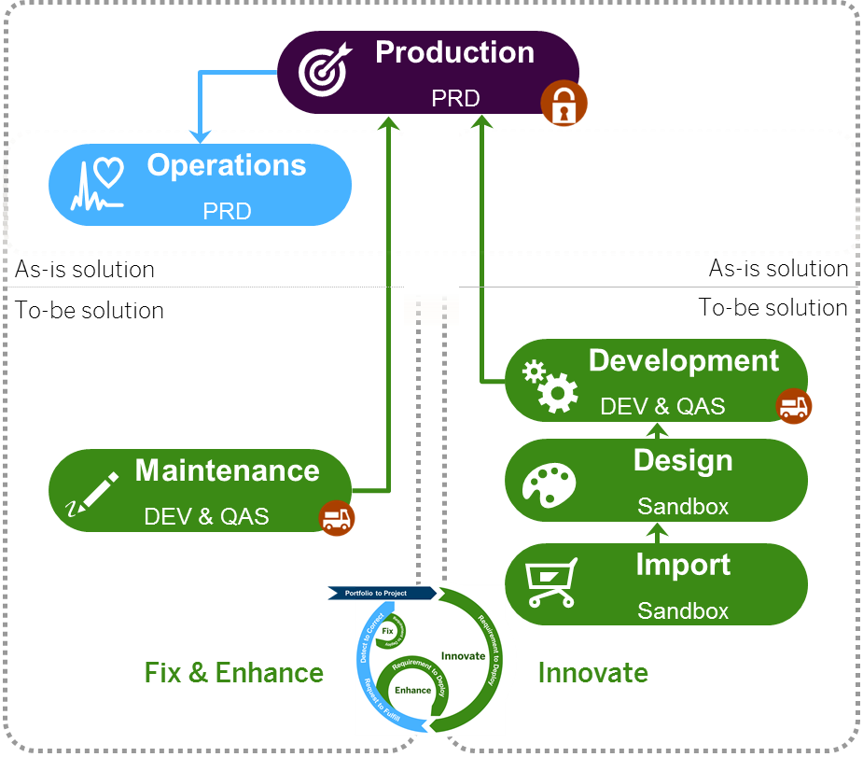
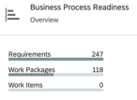
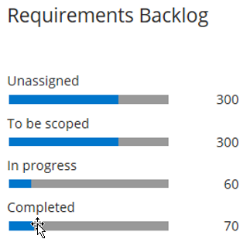
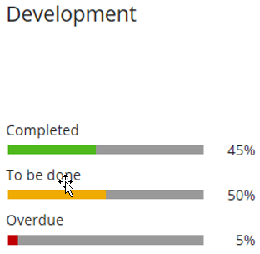
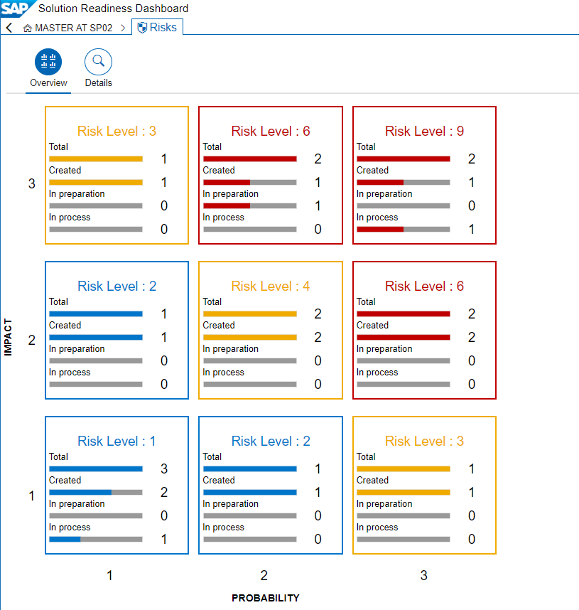
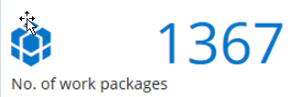
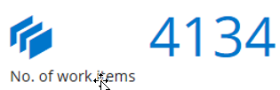
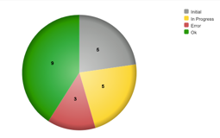

Focused Build – Architecture Overview and Integration Model
Release Management
Change Control Landscape
Release Number and Cycle
Process Management
Requirements / Work Packages / Work Items
Project Management
Wave 1


Process and Application Landscape

Requirements
Work Packages

Sprint 1…n
Design Documents
Task 1…n
Work Items
Branches
Milestone
Test Suite

Q-Gate
Test Plan
Test Cases
Test Package
Focused Build Dashboards

Slide 13
Focused Build Methodology Standard Workflow

Business Analyst/ Process Expert
SBX
QAS
PRE
PRD
Requirements
Approved
In Realization
= Automated action
Realized
Completed
= Manual action

Test Coordinator
Single Functional Test & AT
FIT, RT
Created
Scoping
Scope Finalized
To Be Developed
In Development
In Repair
To Be Tested
Successfully Tested
Handed over to Release
Productive/ Completed
Work Package

Solution Architect
DEV

Technical Tester (Developer)
Unit Test
Work Item
Created
In Development
To Be Tested
Successfully Tested
Handed over to Release
Productive/ Completed
New
In Development
To be tested (Unit)
Test Confirmed
hand over to release
Productive

Developer

Slide 14
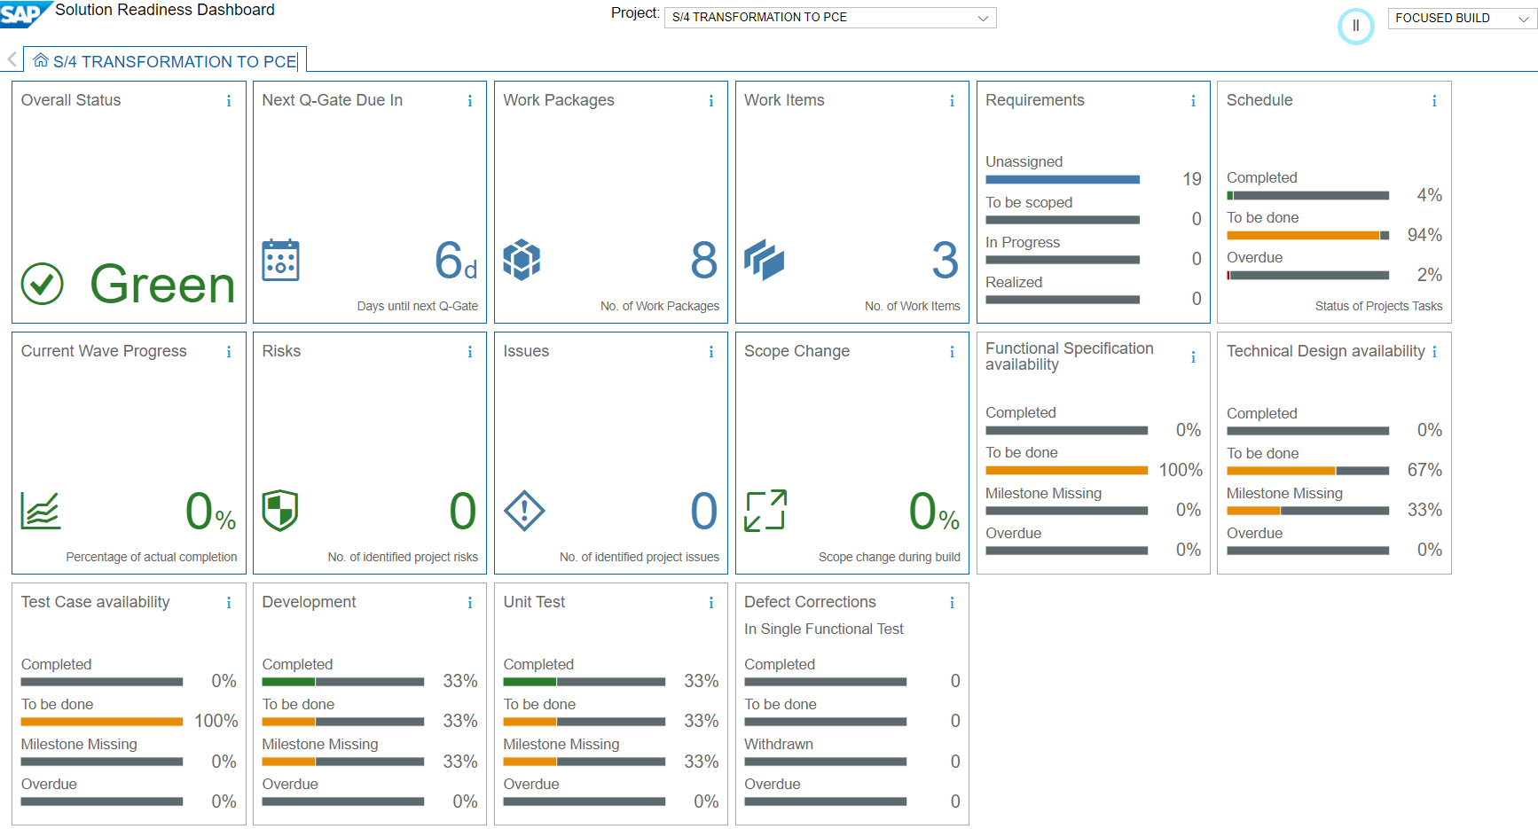
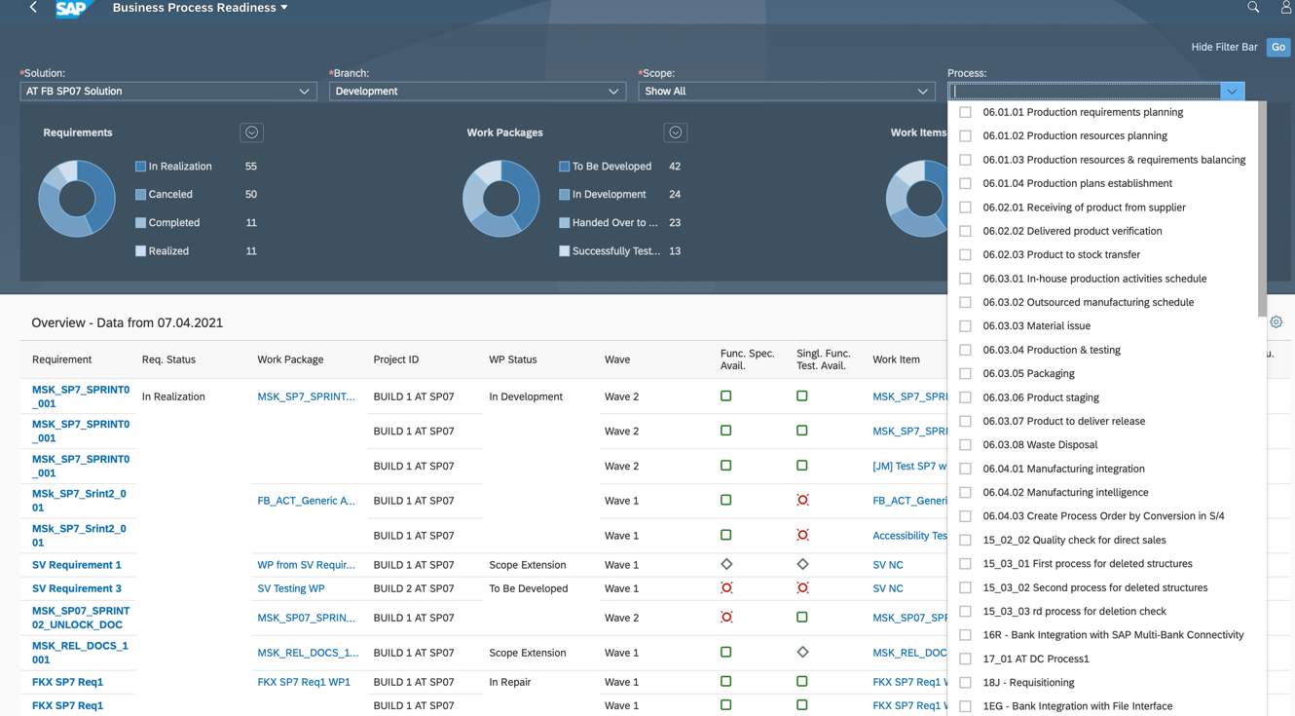
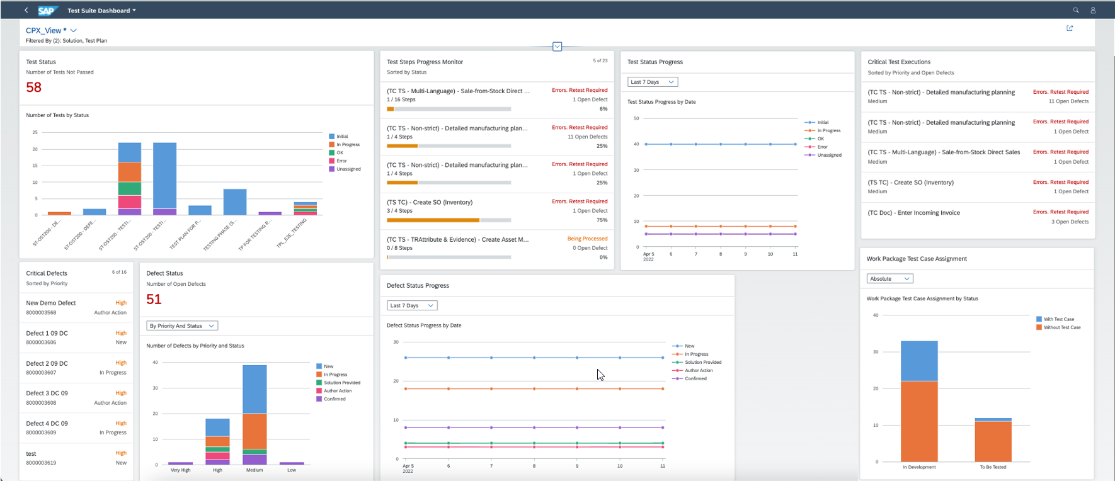
Available Dashboards in Focused Build 1/2
Solution Readiness Dashboard
Gain an overview about the status of your conversion project
Provides information about completed, open and overdue SAP Activate project tasks
Document Reporting Dashboard
Shows current status of implementation from business process perspective
Executable for different branches (overview about planned, active and finished implementation activities for a certain documentation scope or specific business process)
Test Suite Dashboard
Get an overview about the current testing phase
Different Cards available for critical defects, Critical Test Executions, Test Status Progress etc.
Detail Pages allow a deep dive into more granular information

Slide 15
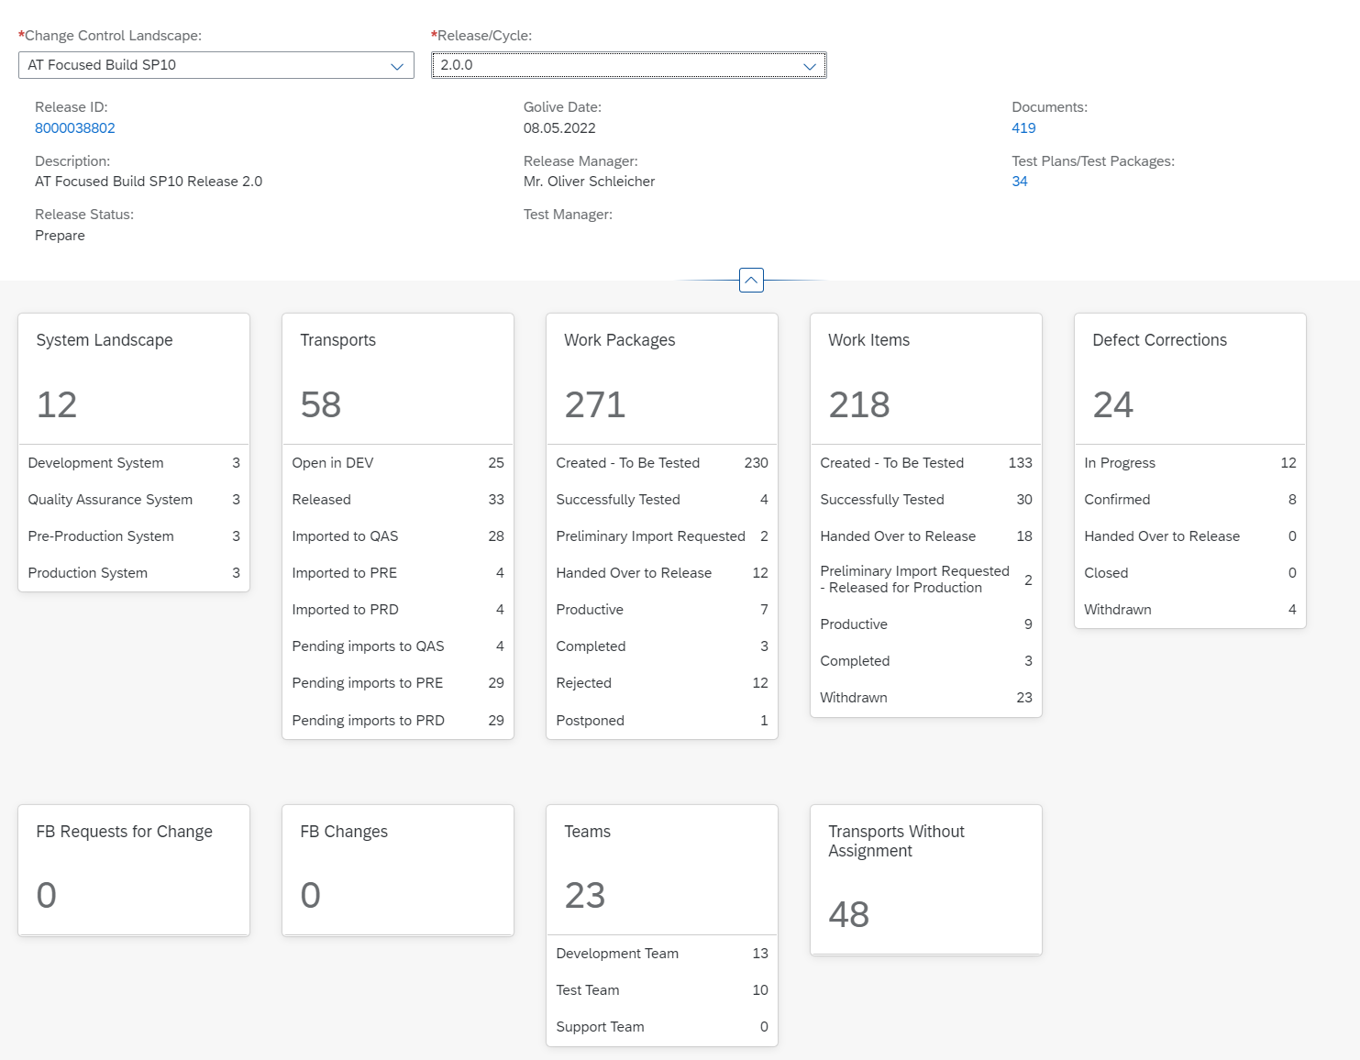
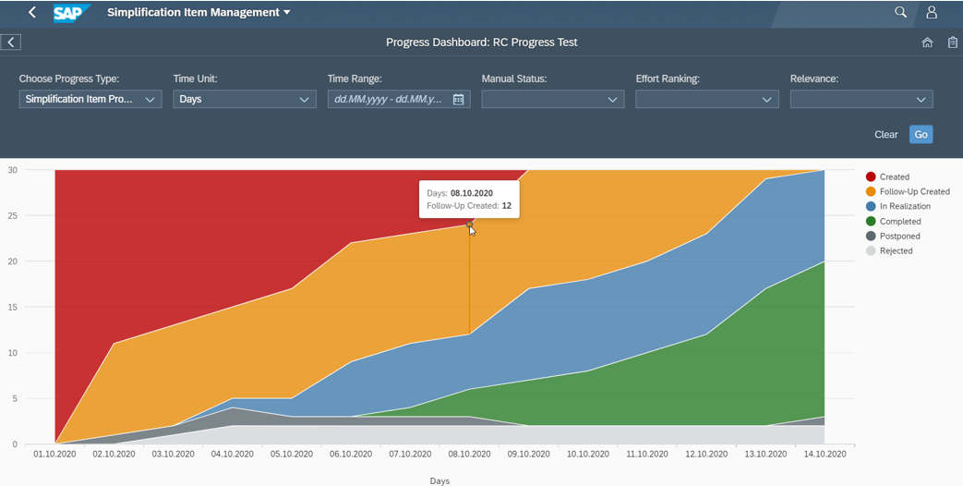
Available Dashboards in Focused Build 2/2
Release Dashboard
Predefined queries allow a quick identification for Release Managers or System Administrators about ongoing transport activities for a Release
Detail Pages show different ratings for selected items (for example Work Packages or Work Items) to ensure proper documentation, testing and transportation
Progress Dashboard for Readiness Check Integration
Powerful Burndown-Chart for Simplification Items and Conversion Activities
Shows the progress of performed conversion steps over a certain period
Allows filtering to focus on most important Activities

Slide 16
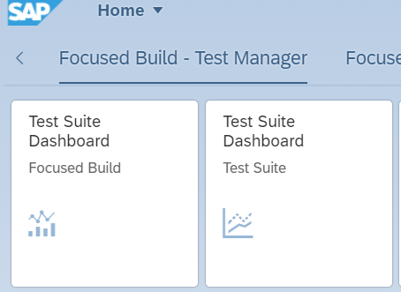
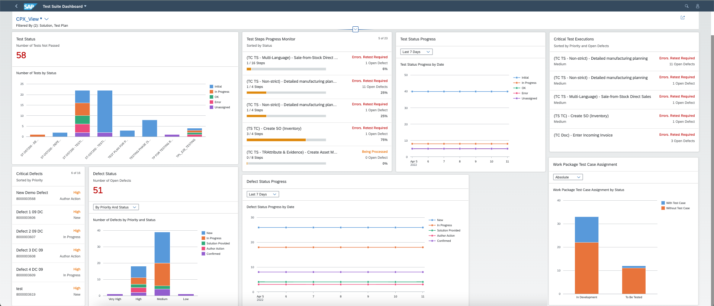
Test Suite – new with SP10 New version of Test Suite Dashboard
Description
With ST-OST SP10, a new version of the Test Suite Dashboard is delivered, using standard Fiori elements. It offers a unique way to analyze data step by step from different perspectives, to investigate a root cause through drilldown, and to act on transactional content.
Notes:
Highlights
Adaptable Overview page
Interactive details pages for detailed customized reports
Customizing and sharing details pages as a page variant with other users
Chart visualization enables users to spot relevant data more quickly

Slide 17
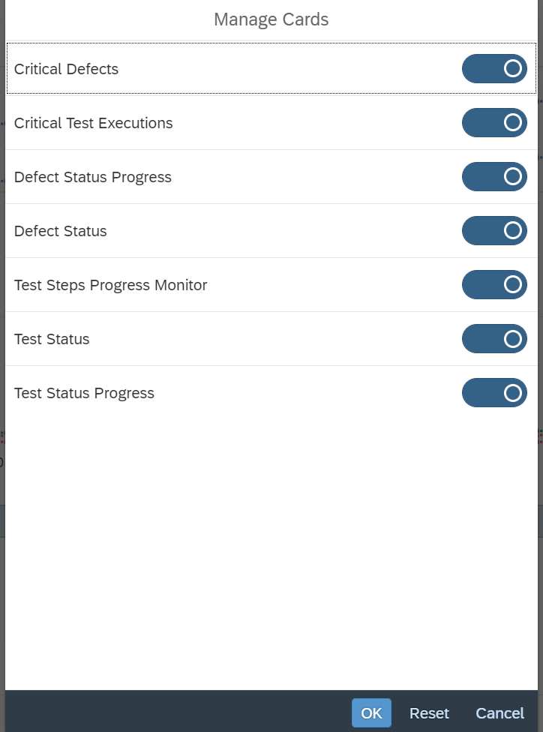

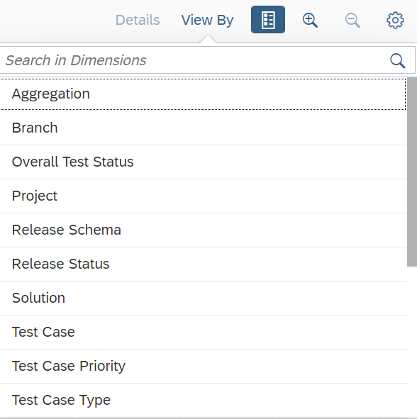
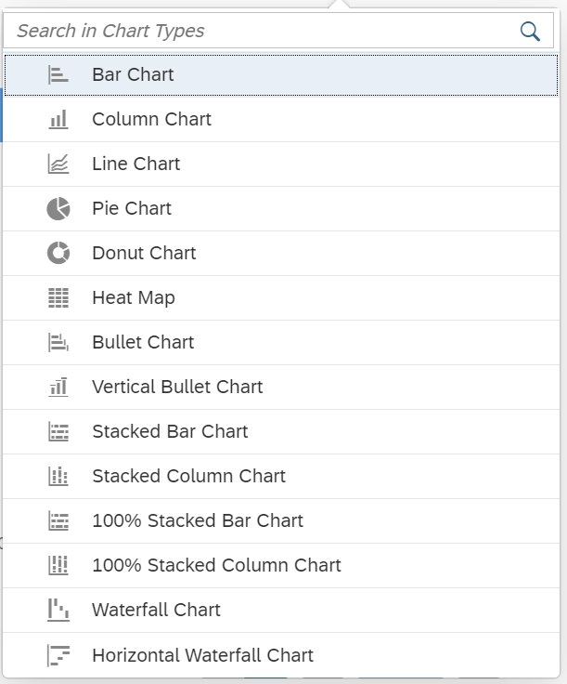
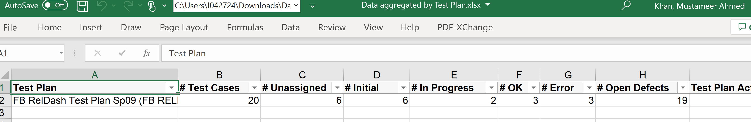
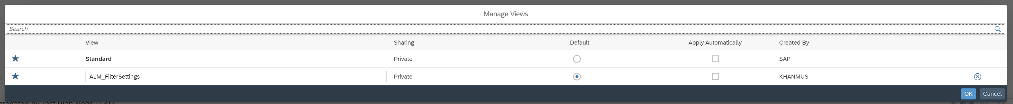
General Capabilities
Customer Connection
Adaptable Overview Pages
Interactive Detail Pages
Easy Creation of Page variants that can be shared
Configurable Chart Visualizations
Tabular data display including reordering and grouping
View by different dimensions
Possibility to download the detailed data
Easily manage the visibility of cards
Share using email or URL, and Save as Tile

Slide 18
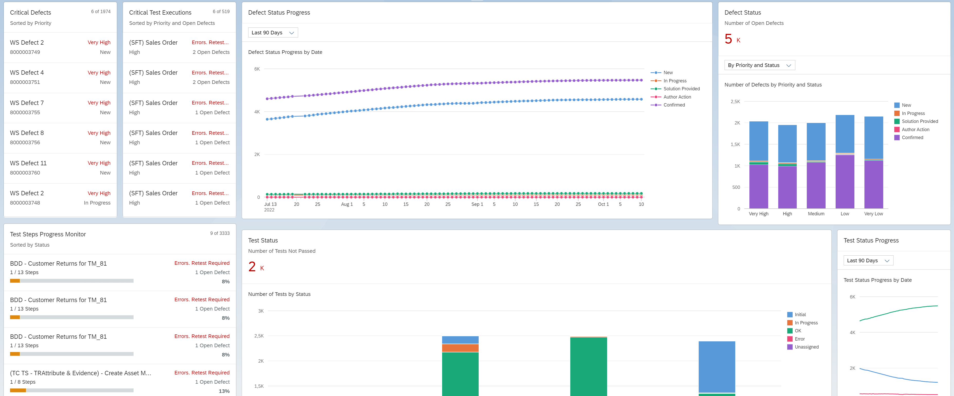
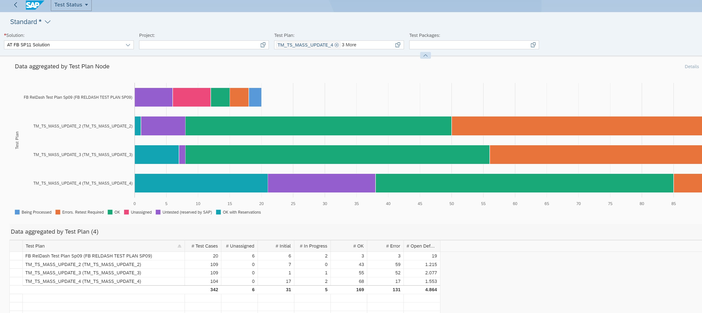
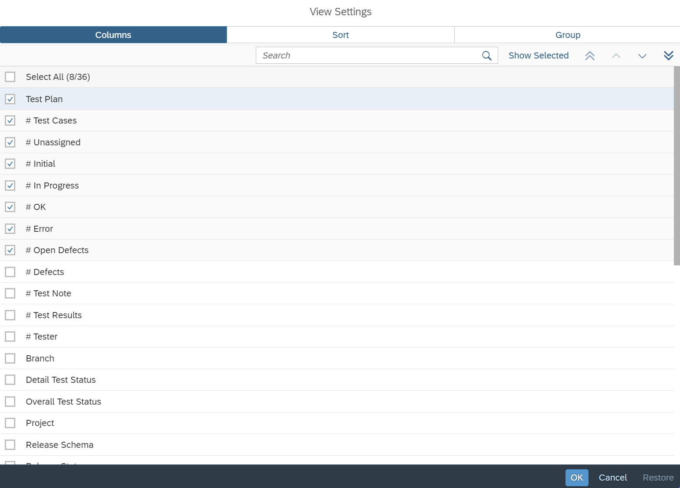
Navigation Paradigm in Test Suite Dashboard
Filter and Variant Management
Overview Page with different Cards
Detail Pages
Variants and Personalization

Slide 19
Demo
Test Suite Dashboard Capabilities

Slide 20
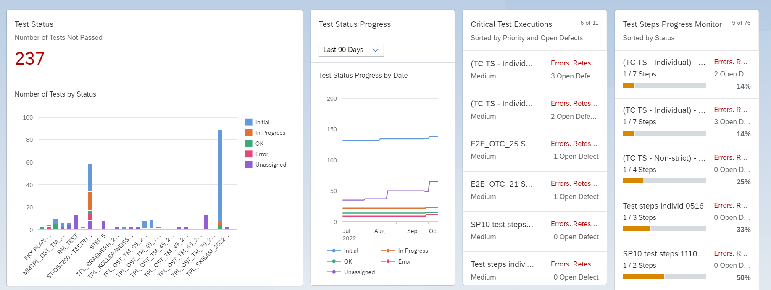
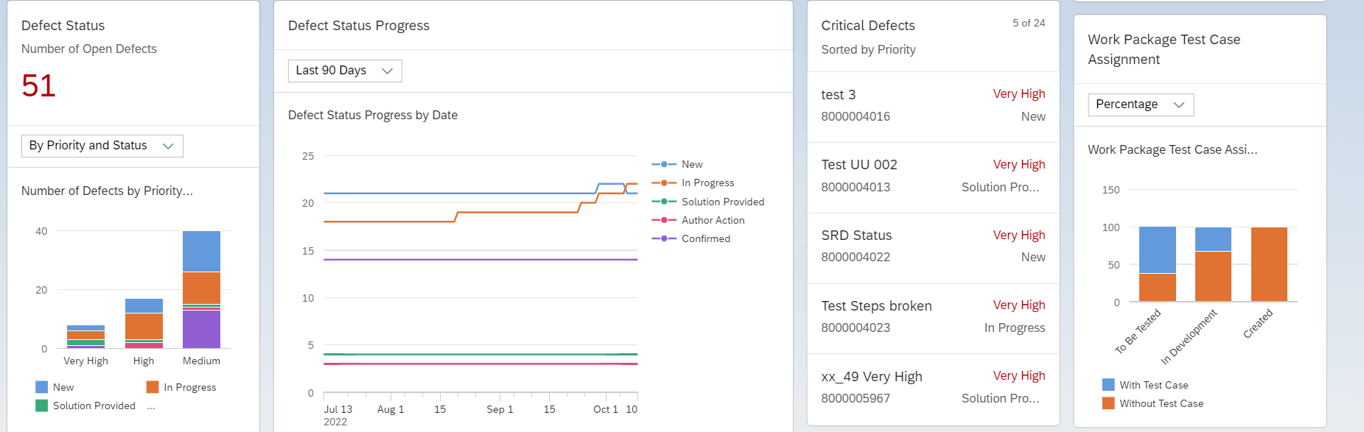
Overview Page in Test Suite Dashboard Different Cards and Usage
Test Status
Test Status Progress
Critical Test Executions
Test Status Progress Monitor
Defect Status
Defect Status Progress
Critical Defects
Work package Test Case Assignment

Slide 21
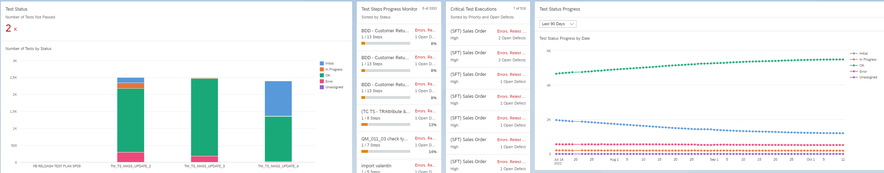
Overview Page in Test Suite Dashboard Different Cards and Usage
Test Cases in different statuses for Test Plans
Shows the Test Step progress based on the status of and the open defects
Shows the critical Test Cases(worst status and open defects)
Test Cases in different statuses and the progress in the selected timeframe

Slide 22
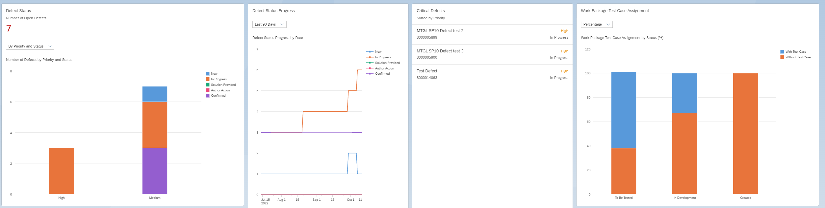
Overview Page in Test Suite Dashboard Different Cards and Usage
Defects in different statuses and priorities
Defects in different statuses for Test Plans for the selected timeframe
Shows the critical defects sorted by priority and processing time
Work packages in different statuses vs Test Case Assignment status

Slide 23
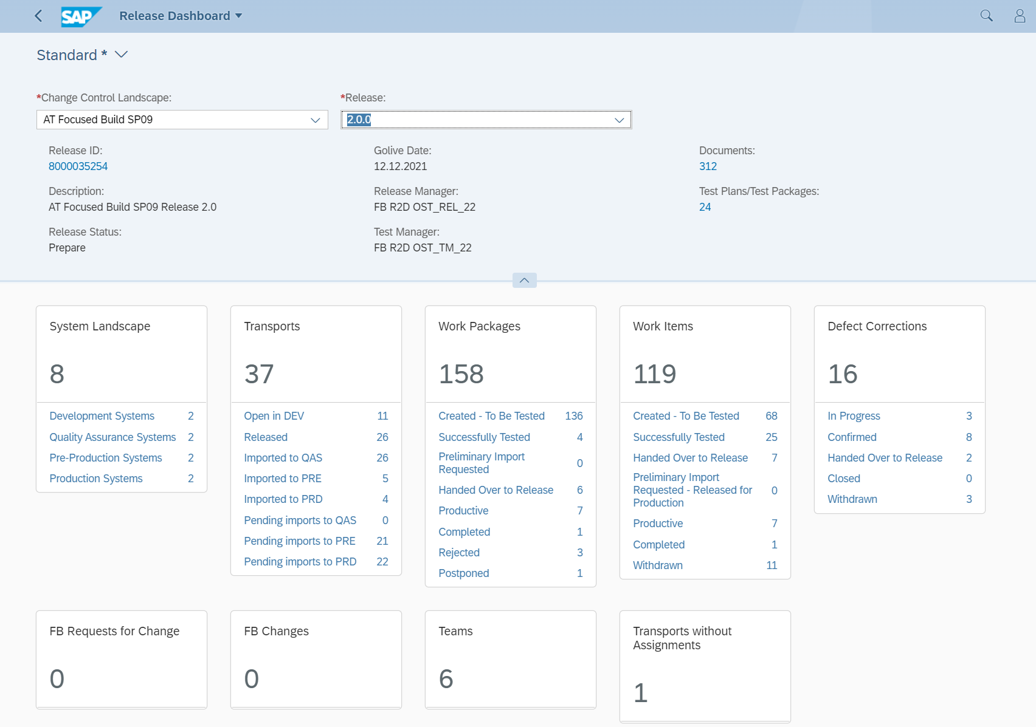
Release Dashboard in Focused Build – released with SP09 New User Interface for Release Dashboard
Initial selection of one release cycle only
Drill down from top level dimensions down to the transport request level
Breadcrumb navigation to show current context
Filter options for work packages, work items, defect corrections, FB requests for change, FB changes and transport requests
Status ratings to evaluate the completeness of releases
Control of pending imports of transport requests
Overview area for the Release
Control of import queues
Easier navigation by preselected subsets of data
Two new tiles for FB Requests for Change and FB Changes

Slide 24
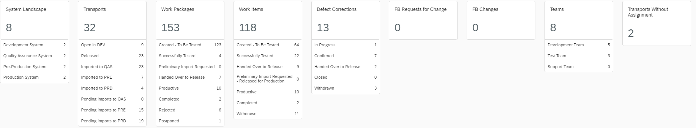
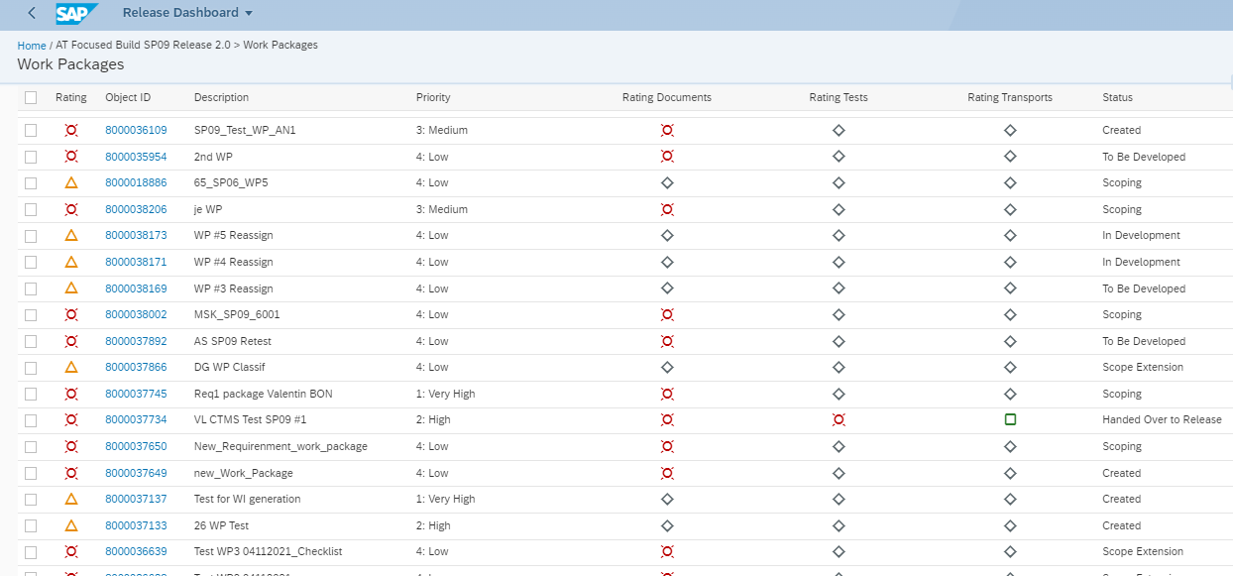
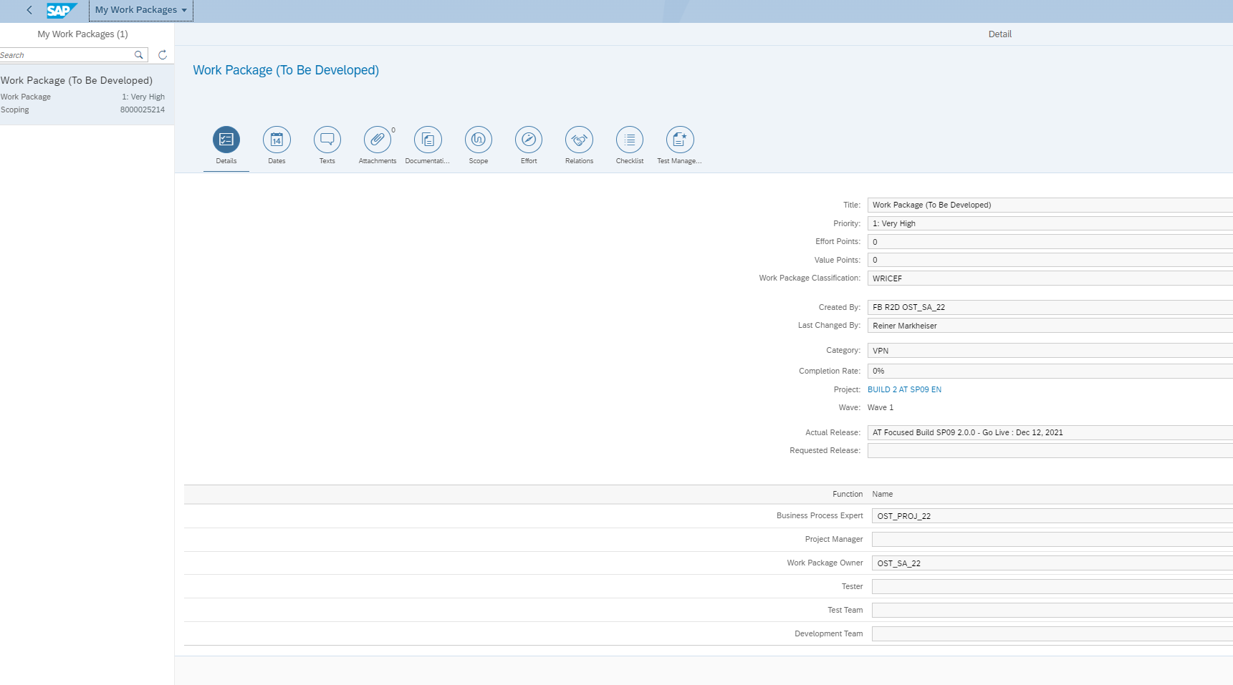
Navigation Paradigm in Release Dashboard
Selection and Variant Management
Overview Page with different Cards
Detail Pages
Contextual Navigation to Applications

Slide 25
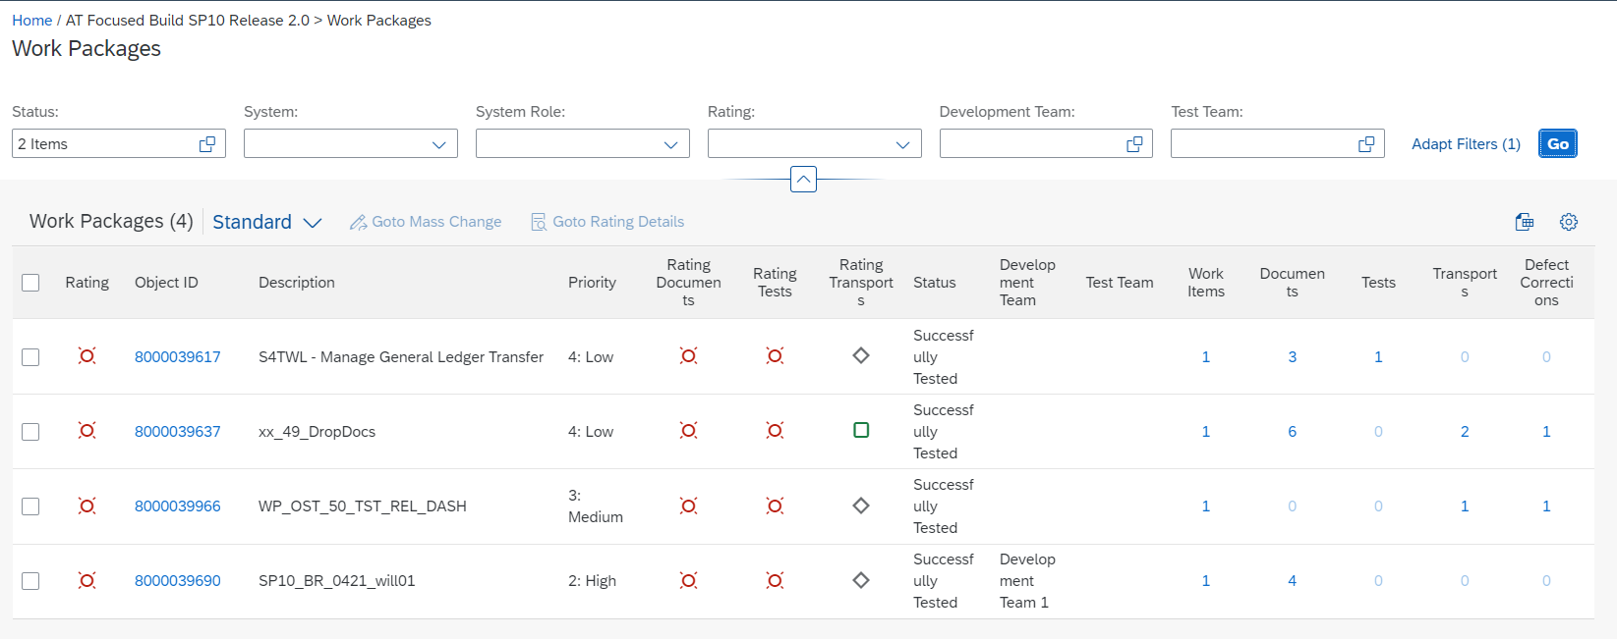
Release Dashboard – Check Readiness for Functional Integration Test
Selection Criteria
Work Package Status = Successfully Tested
Rating Documents = Green
Rating Tests = Green
Rating Transports = Green
Action to be performed
Select Work Packages that fulfill these criteria and navigate to Mass Change Application
Change status of selected Work Packages to “Handed over to Release”
Navigate to Release Batch Import Trigger application and schedule import to Preproduction System

Slide 26
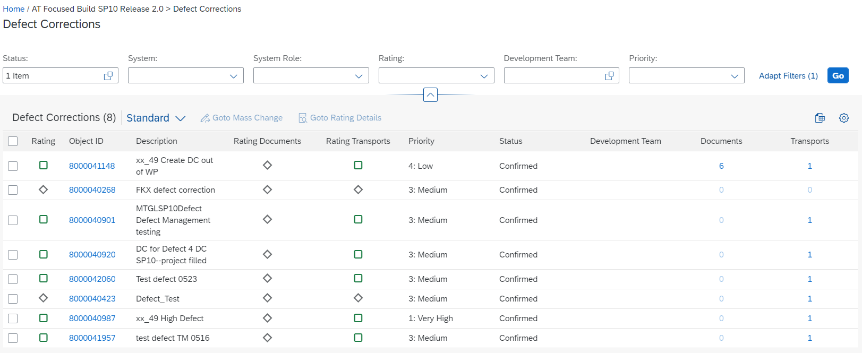
Release Dashboard – Check Readiness for Go-Live
Selection Criteria
Defect Correction Status = Confirmed
Rating Transports = Green
Priority: Very High and High
Action to be performed
Select Defect Corrections that fulfill these criteria and navigate to Mass Change Application
Change status of selected Defect Corrections to “Handed over to Release”
Navigate to Release Batch Import Trigger application and schedule import to Production System

Slide 27
Demo & Exercise
Release Dashboard Capabilities
Check for Readiness of Release for Functional Integration Test
Prepare Go-Live after Functional Integration Test

Slide 28
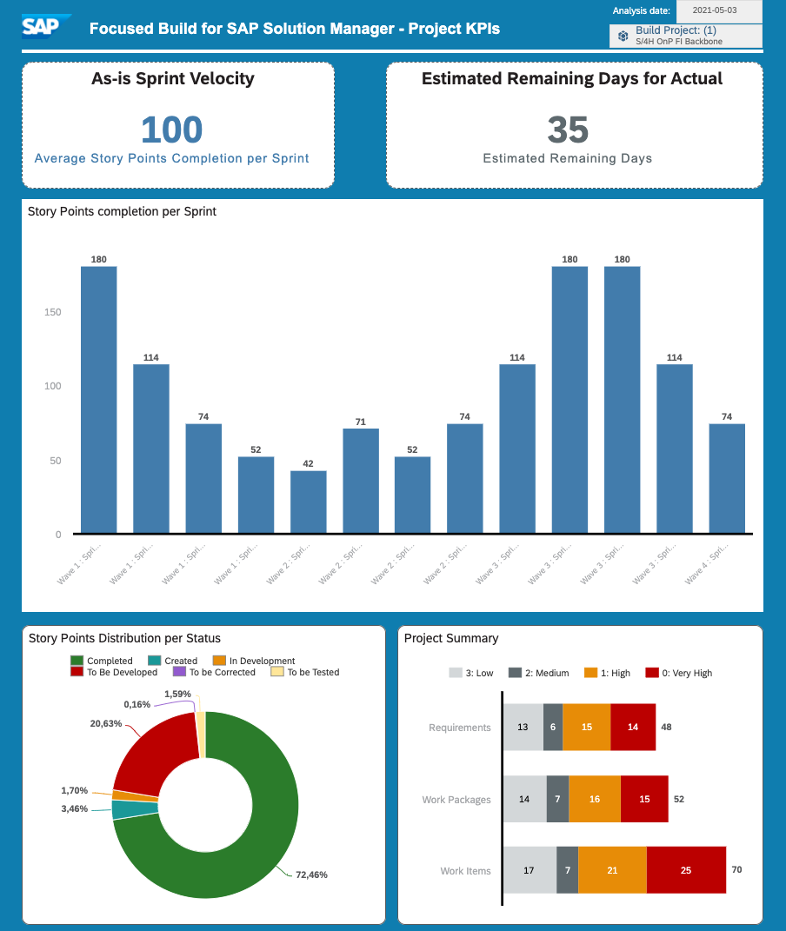
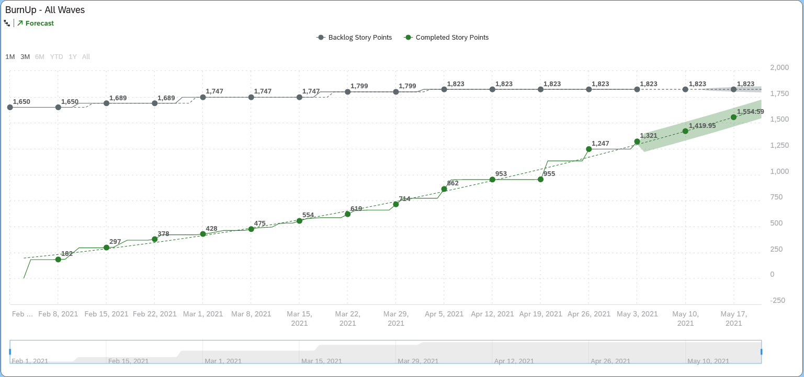
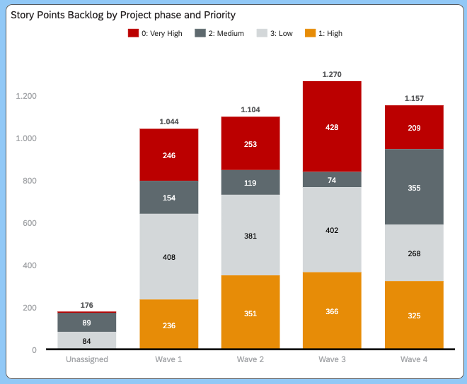
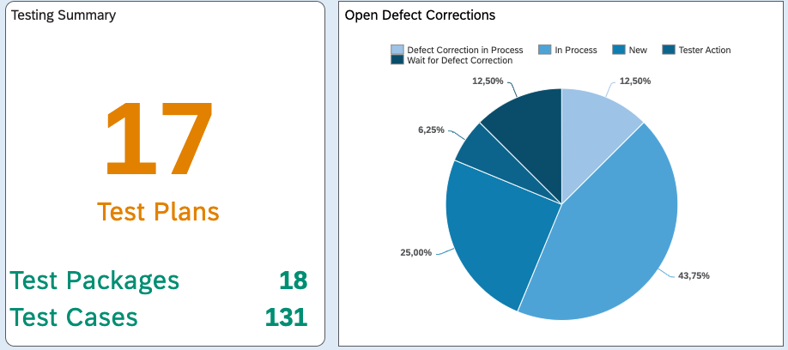
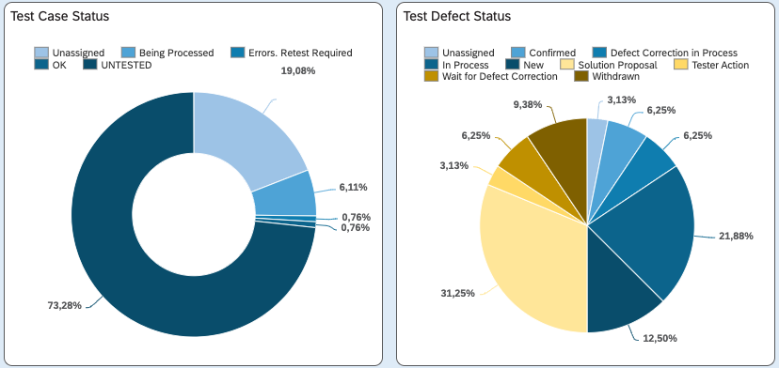
Integration to SAP Analytics Cloud
Features:
Collection report available to regularly move data to SAP Analytics Cloud
Covers the whole Requirements-to-Deploy process including Requirements, Work Packages, Work Items and Test Suite Data
Customers can create their own dashboards tailored to their specific needs
API documentation available in SAP API Hub: https://api.sap.com/api/SAC/overview
Note: SAP Analytics Cloud is an optional Scenario and requires SAP Analytics Cloud subscription

Slide 29
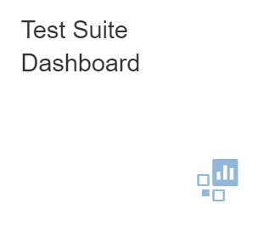
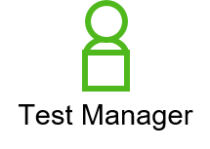
3.24 Track Test Progress with SAC Dashboard
Steps
Connect your SAP Analytics Cloud tenant to the Focused Build system
Schedule the collection report, including Test Suite data
Transfer the data and define a regular update frequency
Create Stories and Dashboards in SAP Analytics Cloud
API documentation available in SAP API Hub: https://api.sap.com/api/SAC/overview
Note: SAP Analytics Cloud is an optional Scenario and requires SAP Analytics Cloud subscription

Slide 30
New Solution Readiness Dashboard

Slide 31
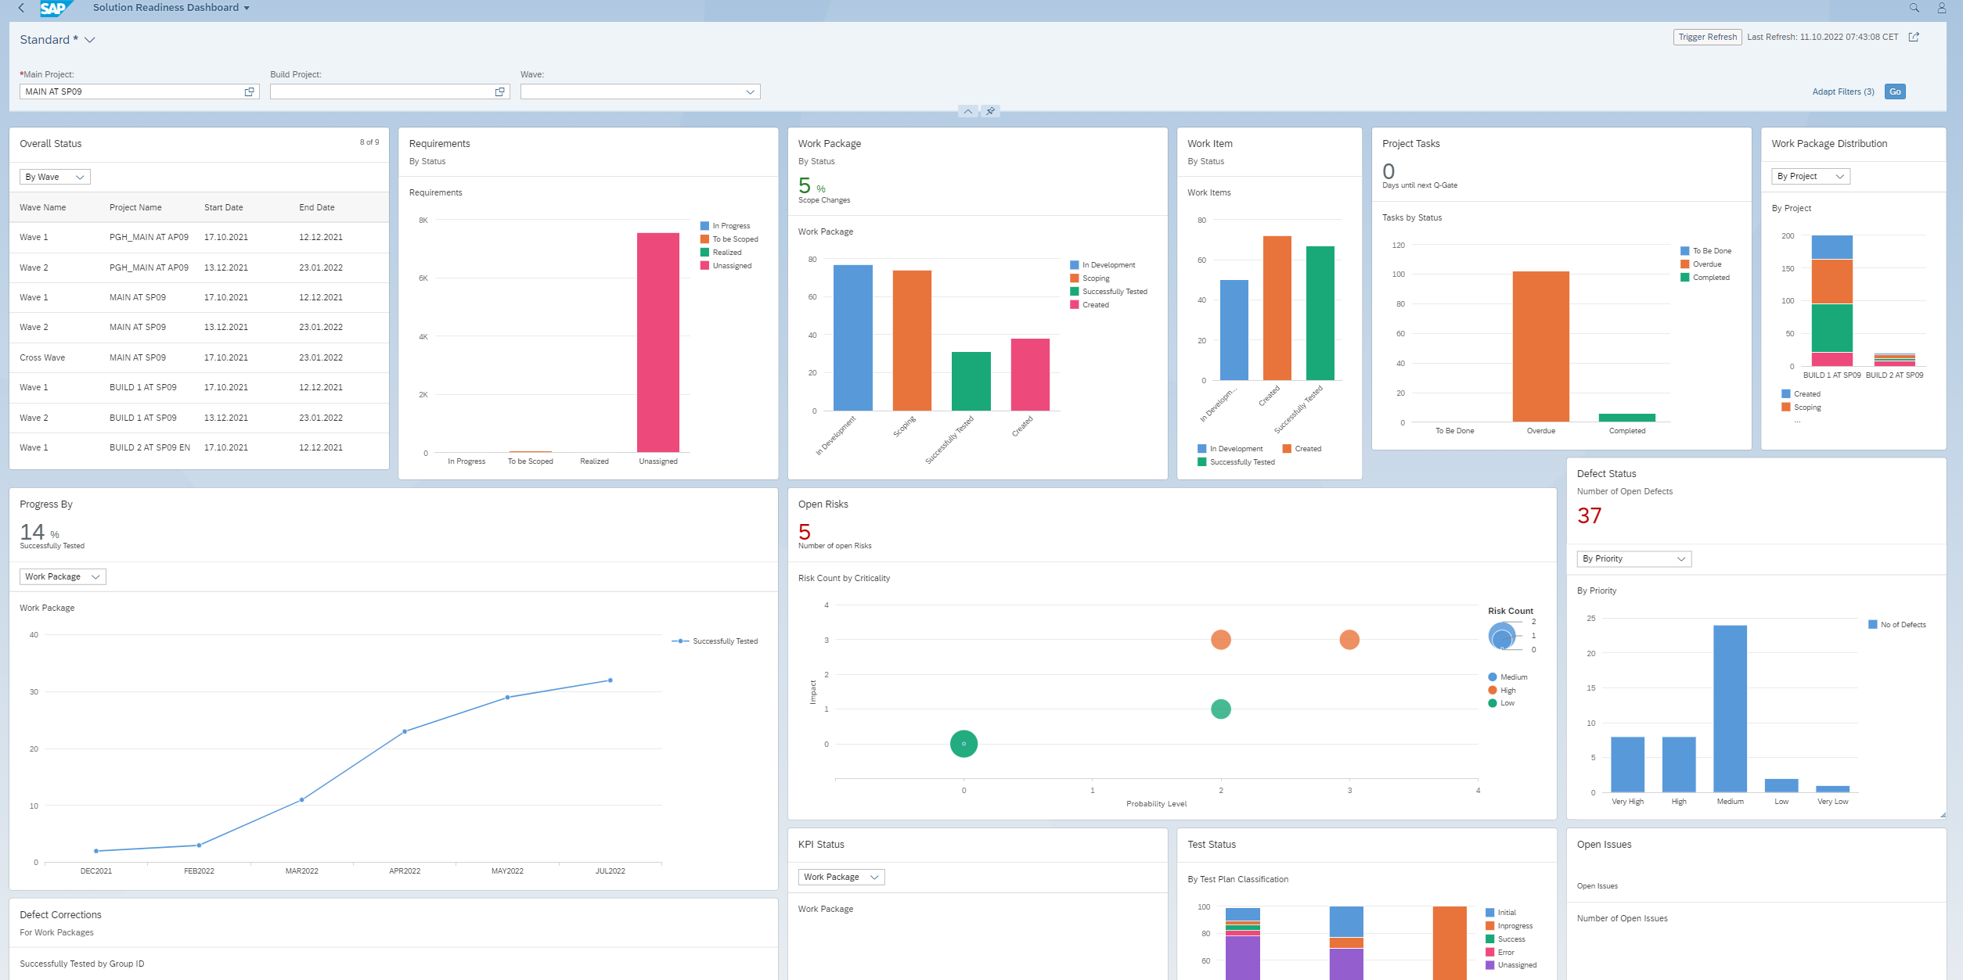
Solution Readiness Dashboard
Lab Preview
A new version of the Solution Readiness Dashboard is being built, using standard Fiori elements.
Provides the possibility to analyze data step by step from different perspectives, to investigate a root cause through drilldown, and to act on transactional content.
This is the current state of planning and may be changed by SAP at any time.
Notes:
Highlights
Adaptable Overview page
Interactive details pages for detailed customized reports
Customizing and sharing details pages as a page variant with other users
Chart visualization enables users to spot relevant data more quickly

Slide 32
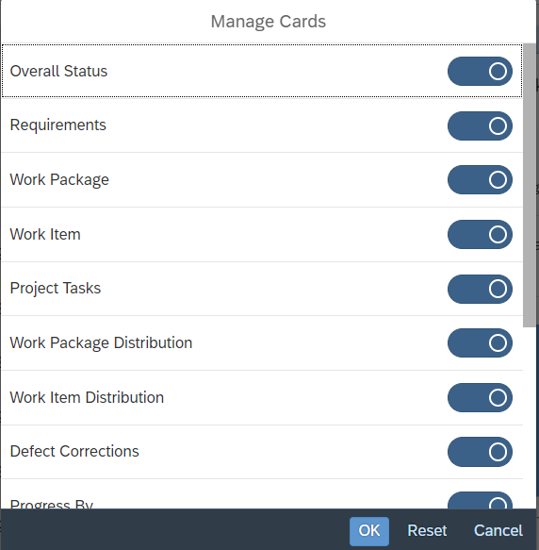
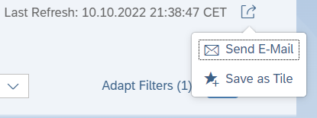
General Capabilities
Lab Preview
Adaptable Overview Pages
Easy Creation of Page variants that can be shared
Configurable Chart Visualizations
Tabular data display including reordering and grouping
View by different dimensions
Possibility to download the detailed data
Easily manage the visibility of cards
Share using email or URL, and Save as Tile
This is the current state of planning and may be changed by SAP at any time.

Slide 33
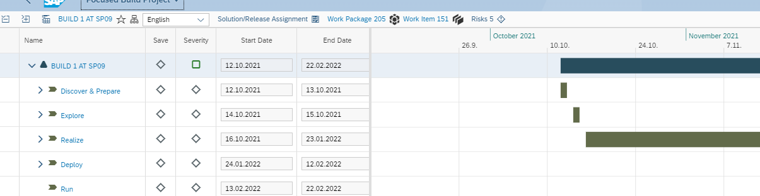
Navigation Paradigm in Solution Readiness Dashboard
Filter and Variant Management
Overview Page with different Cards
Detail Pages
Variants and Personalization
Contextual Navigation to Applications

Slide 34
Overview Page in Solution Readiness Dashboard Different Cards and Usage
Lab Preview
14 Cards in the Overview page
Individual detail page for each overview card with dimensions and measures
Trigger Refresh to fetch the latest data
Possibility to share by e-mail or save as Tile
This is the current state of planning and may be changed by SAP at any time.

Slide 35
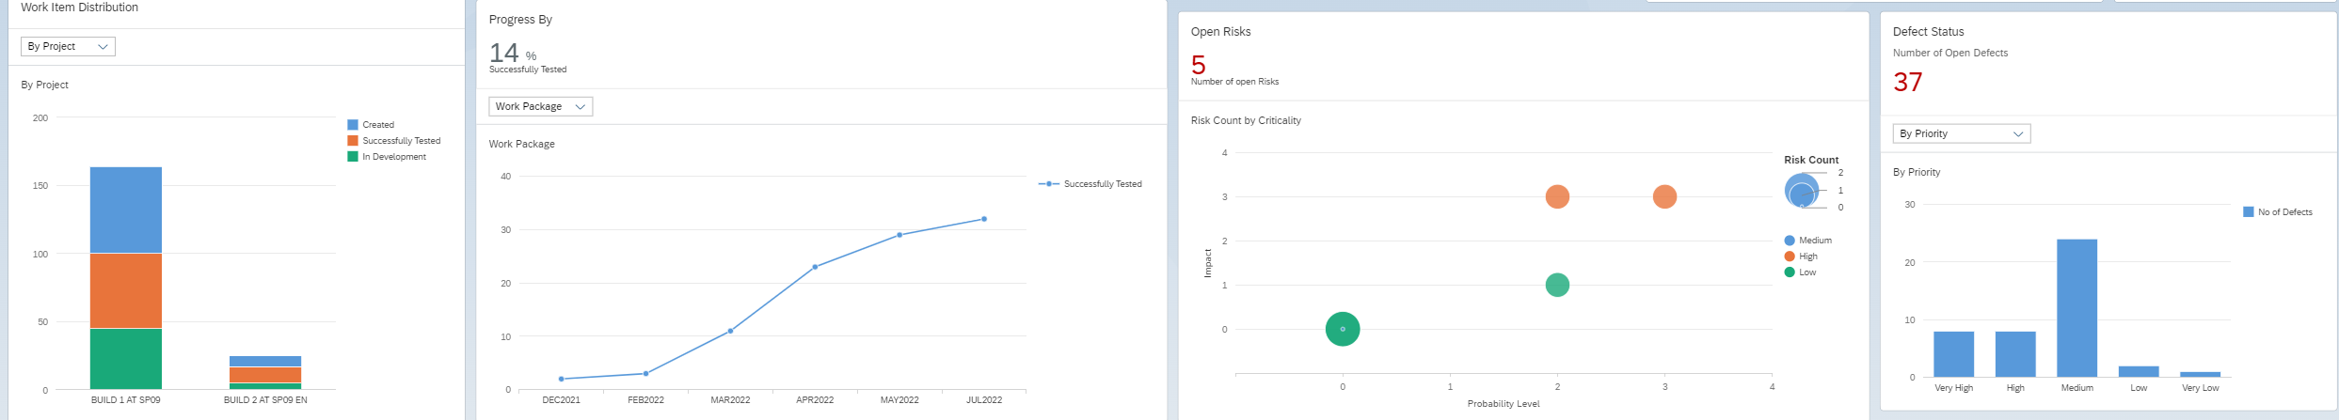
Overview Page in Solution Readiness Dashboard Different Cards and Usage
Lab Preview
Work Item distribution in different statuses based on Projects, Waves and Category
Progress of the Work packages and Work items
Open Risks based on the Impact and Probability Level
Defects in different statuses and priorities
This is the current state of planning and may be changed by SAP at any time.

Slide 36
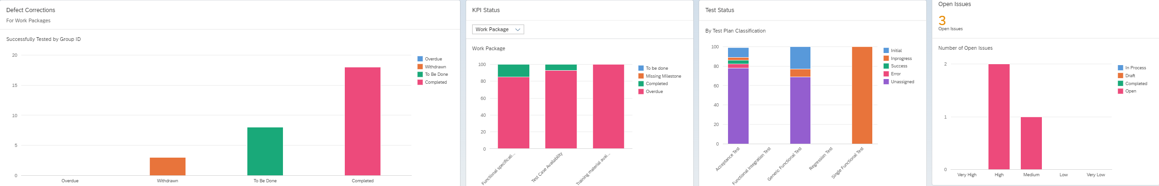
Overview Page in Solution Readiness Dashboard Different Cards and Usage
Lab Preview
Defect corrects for work packages in different statuses
KPI status for work package and work item
The status of Tests on Test Plan Classification
Open issues in different priorities
This is the current state of planning and may be changed by SAP at any time.

Slide 37
Demo
Lab Preview Solution Readiness Dashboard

Slide 38
SAP Cloud ALM for implementation

Slide 39


SAP Cloud ALM for implementation – A Process View
Analytics
Project Tracking & Overview
Tracebility*
Tenant Request
Business Go Live
Design
Build
Test
Deploy
Consume best practice content, perform Fit-to-Standard Workshops and manage requirements
Perform configuration activities and manage extensions
Manage integration and acceptance tests
Orchestrate consistent deployment to production

Slide 40

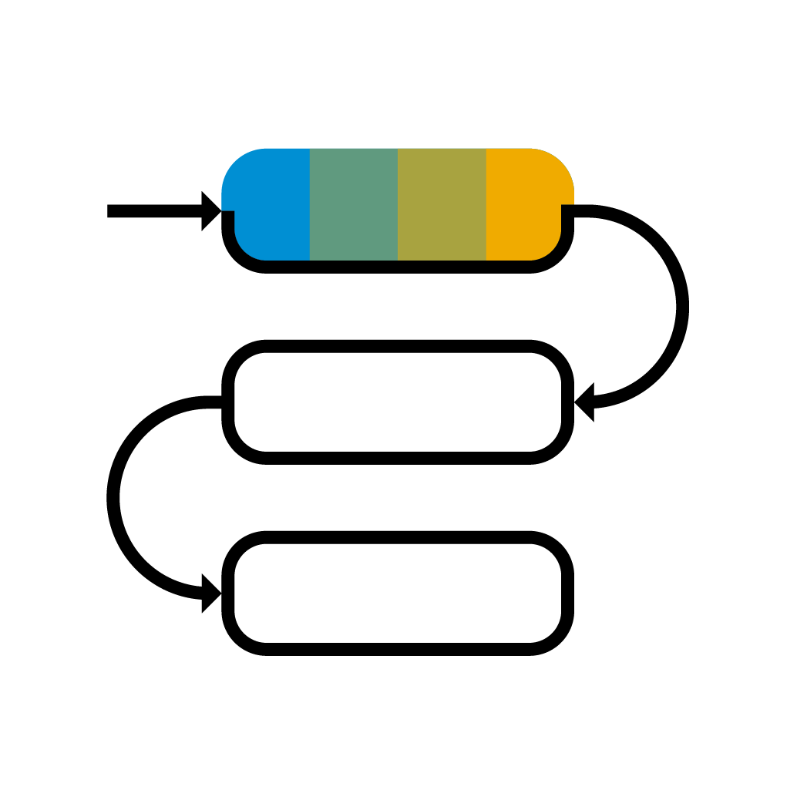





High flexibility provided by SAP Cloud ALM
Free choice of used capabilities depending on
Functional needs
Implementation use case; e.g. S/4HANA Cloud, S/4HANA Private Cloud, Success Factors
Integration of third party solutions

Slide 41
Maximum Value by using integrated E2E implementation process
Utilize entity relations as basis for an integrated process
Manage entity dependencies and implementation process governance via traceability views
Solution Process Traceability
Requirement Traceability
Feature Traceability
Requirement driven implementation to support customer specific innovation

Slide 42




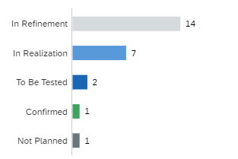
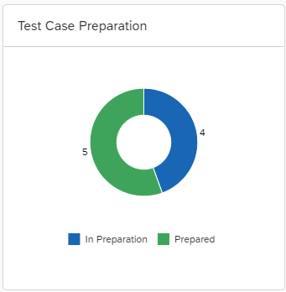



Requirement Driven Implementation End-to-end implementation model
Process Management
Project and Task Management
Test Management



Solution Processes
Notes
Requirements
Test Cases
SAP Best Practices

User Stories
Change and Deployment Management
SAP Activate Task Templates



SAP Central Business Configuration Projects
Template Tasks
Project Tasks
Features and Releases
Analytics and Traceability

Slide 43




Analytics and Traceability
Overview Page
Central entry for project manager and member
Aggregated and organized view on all aspects of the project in one location
Allows user specific view on project status and related activities
Analytics
Advanced analytics
Traceability views for E2E implementation process governance
Various charts to track progress of
Task execution
Test Execution
Defect Resolution

Slide 44


SAP Cloud ALM – Consumption of SAP Activate based roadmaps
Implementation based on SAP Activate Methodology
Tasks automatically assigned to roles
Set detailed due dates or derive from phases
Mass change of task attributes
Creation of manual tasks
List and Gantt view

Slide 45



SAP Cloud ALM – Process Content Viewer for SAP Best Practice Content
Implementation based on SAP Best Practice Process Content and Intelligent Enterprise Scenarios
Process Based scoping for Fit-to-Standard Workshops
Creation of requirements on process models
Detailed access to
BPMN process models
Test Scripts
Executables

Slide 46


SAP Cloud ALM – Customer Content Authoring
Create your own solution processes
Simple versioning with draft and active versions
Maintain Value Flow diagrams
Use customer processes in
Requirements Management
Test Management
Upcoming next:
History of changes
Creation of solution flows with BPMN modelling

Slide 47
SAP Cloud ALM – Test Orchestration
SAP Cloud ALM
Easy to consume solution
Open to support all products in the future:
Cloud and On-Premise
SAP and non SAP
Test Orchestration
Scoping
Manual Functional Testing
Automated Functional Testing
Requirement Traceability
Defect Management
Test Automation:
Integration of Cloud-based Test Automation providers:
Test automation tool for SAP S/4 HANA Cloud
Tricentis Test Automation*
Test Orchestration
Manual Testing
Test Automation Framework
S/4 Cloud Test Automation Tool
Test Automation Providers
*This is the current state of planning and may be changed by SAP at any time.

Slide 48


Deployment managed via Feature
Feature is the entity for change documentation and deployment orchestration
Easily assign transports and trigger their deployment throughout your landscape
Traceability ensured via the history of a feature

Slide 49






Deployment integration
available
available
On-Premise
Enterprise Cloud Services
Public Cloud
,
private edition
CTS
CTS
Cloud TMS
available
Change Management & Deployment Orchestration
This is the current state of planning and may be changed by SAP at any time.

Slide 50
E2E Implementation Process Flow
Create Project Tasks (optional)
Complete Project Task
Defect Process
Select Process Context
Create Requirement
Approval of Requirement
Create / Assign AT/FIT Test Case
Requirement Ready for Test
Execute AT/FIT
Confirm Requirement
Create Feature
Assign Transport
Deployment to QAS
Deployment to PRD
Create/Plan User Stories for Developments
Process User Story
Complete User Story
Create Sub-tasks for User Stories
Process/Complete Sub-Tasks for User Stories

Slide 51
E2E Implementation Process – Requirement Ready for Implementation
Create Project Tasks (optional)
Complete Project Task
Defect Process
Select Process Context
Create Requirement
Approval of Requirement
Create / Assign AT/FIT Test Case
Requirement Ready for Test
Execute AT/FIT
Confirm Requirement
Create Feature
Assign Transport
Deployment to QAS
Deployment to PRD
Create/Plan User Stories for Developments
Process User Story
Complete User Story
Create Sub-tasks for User Stories
Process/Complete Sub-Tasks for User Stories

Slide 52

E2E Implementation Process – Requirement Ready for Implementation
Selection Criteria
Requirement Status = In Approval
Approval Status = Approved
Action to be performed
Navigate to Requirement
Set Requirement Status to “In Realization”
Create Feature for Requirement
Create User Stories for Feature / Requirement
Create/assign Test Cases

Slide 53
E2E Implementation Process – Requirement Ready for Test
Create Project Tasks (optional)
Complete Project Task
Defect Process
Select Process Context
Create Requirement
Approval of Requirement
Create / Assign AT/FIT Test Case
Requirement Ready for Test
Execute AT/FIT
Confirm Requirement
Create Feature
Assign Transport
Deployment to QAS
Deployment to PRD
Create/Plan User Stories for Developments
Process User Story
Complete User Story
Create Sub-tasks for User Stories
Process/Complete Sub-Tasks for User Stories

Slide 54

Traceability for Requirements view – Ready for Test
Selection Criteria
Requirement Status = In Realization
Test Preparation = All test cases with same status: Prepared
User Story Status = All user stories with same status: Done
Action to be performed
Navigate to Feature and deploy to QAS
Set Requirement Status “To Be Tested”
Start test execution

Slide 55
E2E Implementation Process – Ready for Deployment
Create Project Tasks (optional)
Complete Project Task
Defect Process
Select Process Context
Create Requirement
Approval of Requirement
Create / Assign AT/FIT Test Case
Requirement Ready for Test
Execute AT/FIT
Confirm Requirement
Create Feature
Assign Transport
Deployment to QAS
Deployment to PRD
Create/Plan User Stories for Developments
Process User Story
Complete User Story
Create Sub-tasks for User Stories
Process/Complete Sub-Tasks for User Stories

Slide 56

Traceability for Requirements – Ready for Deployment
Selection Criteria
Requirement Status = To Be Tested
Test Execution Status = All test cases with same status: Passed (only one feature)
User Story Status = All user stories with same status: Done
Action to be performed
Navigate to feature of requirement to set status to “Ready for Deployment”

Slide 57
Demo
Cloud ALM Analytics

Slide 58
Additional Information

Slide 59



Focused Build learning material
Focused Build Introduction
Overview
How to get started
Release notes
Functional & Conceptual overviews
S/4HANA Conversion Project Support
Deployment and Release
Project Management
Process Management
…
Role-based usage training material
Role-specific training curriculum
Cloud trial system
Role-specific demos in media center
Free openSAP training

Slide 60

Join Focused Build communities
Access rollout material and join discussion forums about SAP Solution Manager 7.2 and focused solutions
SAP Support Portal
Focused Solutions Wiki and FAQs
Should you have other questions, you can contact us at focused.solutions@sap.com
Use the tag “Focused Build and Focused Insights for SAP Solution Manager“ in SAP Community Network to exchange experiences or raise questions about Focused Build

Slide 61








Additional Information SAP Cloud ALM
Find out more (Homepage)
Learn what’s new (SAP Help Portal)
See what’s planned (Roadmap)
Experience it (Demo Center)
Request it (Order form)
Get help (In-app help)
Give feedback (Qualtrics)
Contact us (E-mail)

Slide 62
Q&A

Slide 63




Open new career opportunities Join the community of people with skills for the future
Mandatory Slide - Talk track available in the notes
Check learning.sap.com/teched to benefit like other certified experts:
61%
Get promotions¹
91%
>71%
Increase
Increase
confidence in abilities¹
problem-solving skills²
Become an SAP solution expert – now as easy as 1,2,3 in one place:
Expand your conference experience:
Follow expert-led learning journeys and live sessions for various development roles to upskill and prepare for certification
Benefit from the event-exclusive certification offer
FREE
Connect with experts, share your knowledge, expand your network, and collaborate with peers in SAP Community
Network with other participants in the group for SAP TechEd and join the SAP Learning Groups to get your learning questions answered
FREE
SAP TechEd OFFER
FREE
1. Pearson VUE’s Latest “Value of IT Certification” Study Highlights Benefits of IT Certification in Challenging Times,” Pearson Education Inc., May 25, 2021.
2. Chuck Cooper, Why Get IT Certified? The Value of IT Certification: An IT Certification White Paper, IT Certification Council, March 2021.
Notes:
Here are some great learning offerings to compliment your conference.
You can prepare for a certification in development roles with free SAP Learning Journeys and live learning sessions led by SAP experts
Save with an exclusive SAP TechEd certification offer that came in your SAP TechEd registration email
Connect with the experts, expand your network, and share your knowledge and experiences with others in the SAP Community
And network in a moderated SAP Learning Group to get your learning questions answered
Find all the great content at learning.sap.com/teched.

Slide 64
Reiner Markheiser
Joerg Marenk
reiner.markheiser@sap.com
joerg.marenk@sap.com

